Slide 1


JPAD Commander
Design of Aircraft and Flight technologies RESEARCH GROUP
A Graphic User Interface (GUI) for the JPAD library
Vittorio Trifari
vittorio.trifari@unina.it

Slide 2
Introducing JPADCommander
A user-friendly graphic interface for the JPAD library.
Designed as a wizard that will guide the user from the definition of the aircraft model to the post-processing of the analyses results.
Possibility to generate and export the CAD model of the aircraft in exam

Slide 3
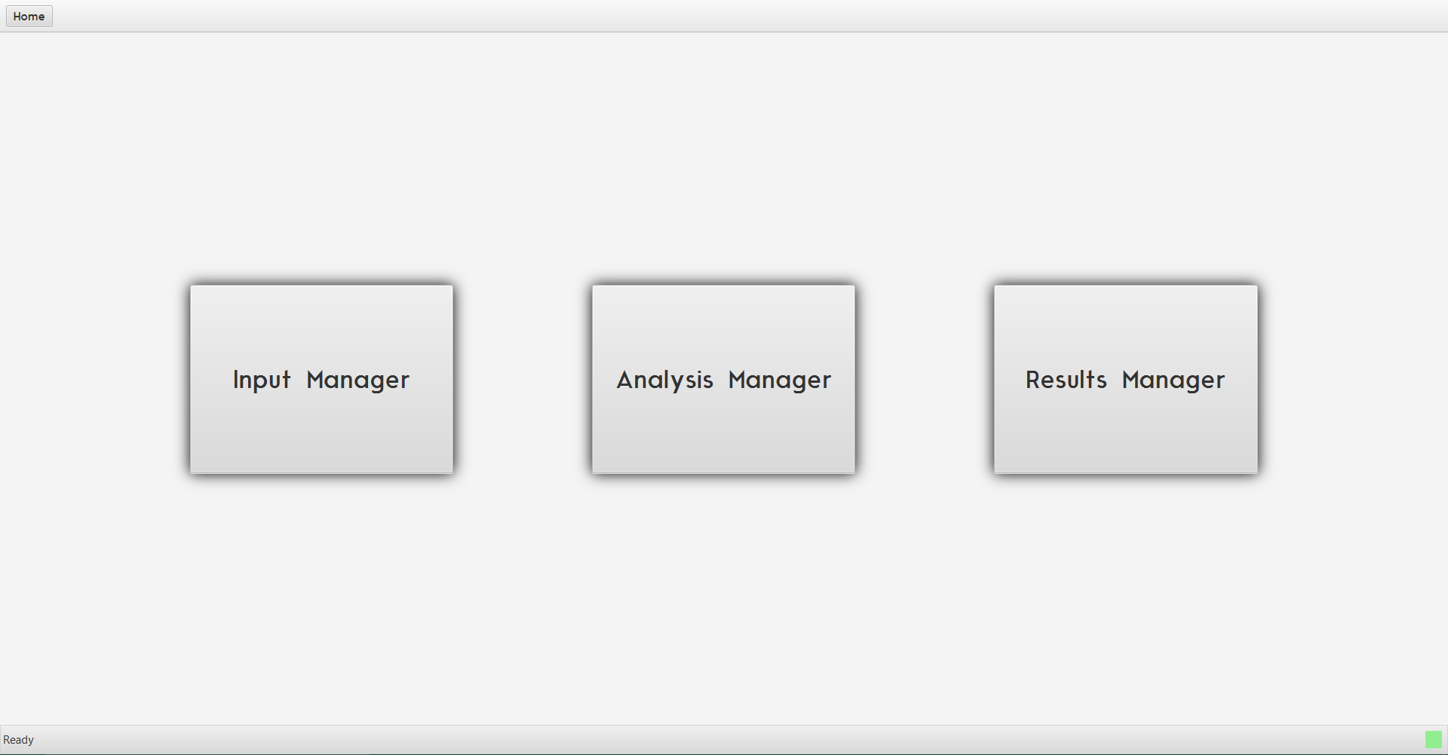
JPADCommander – Main view

Slide 4
JPADCommander - Input
Three ways of aircraft definition:
Form XML file
From Default aircraft model (only ATR-72 at the moment)
By filling all the fields manually
Possibility to define a modular aircraft and combine different components.
Possibility to define only some aircraft components.
Parametric representation of each aircraft component.

Slide 5
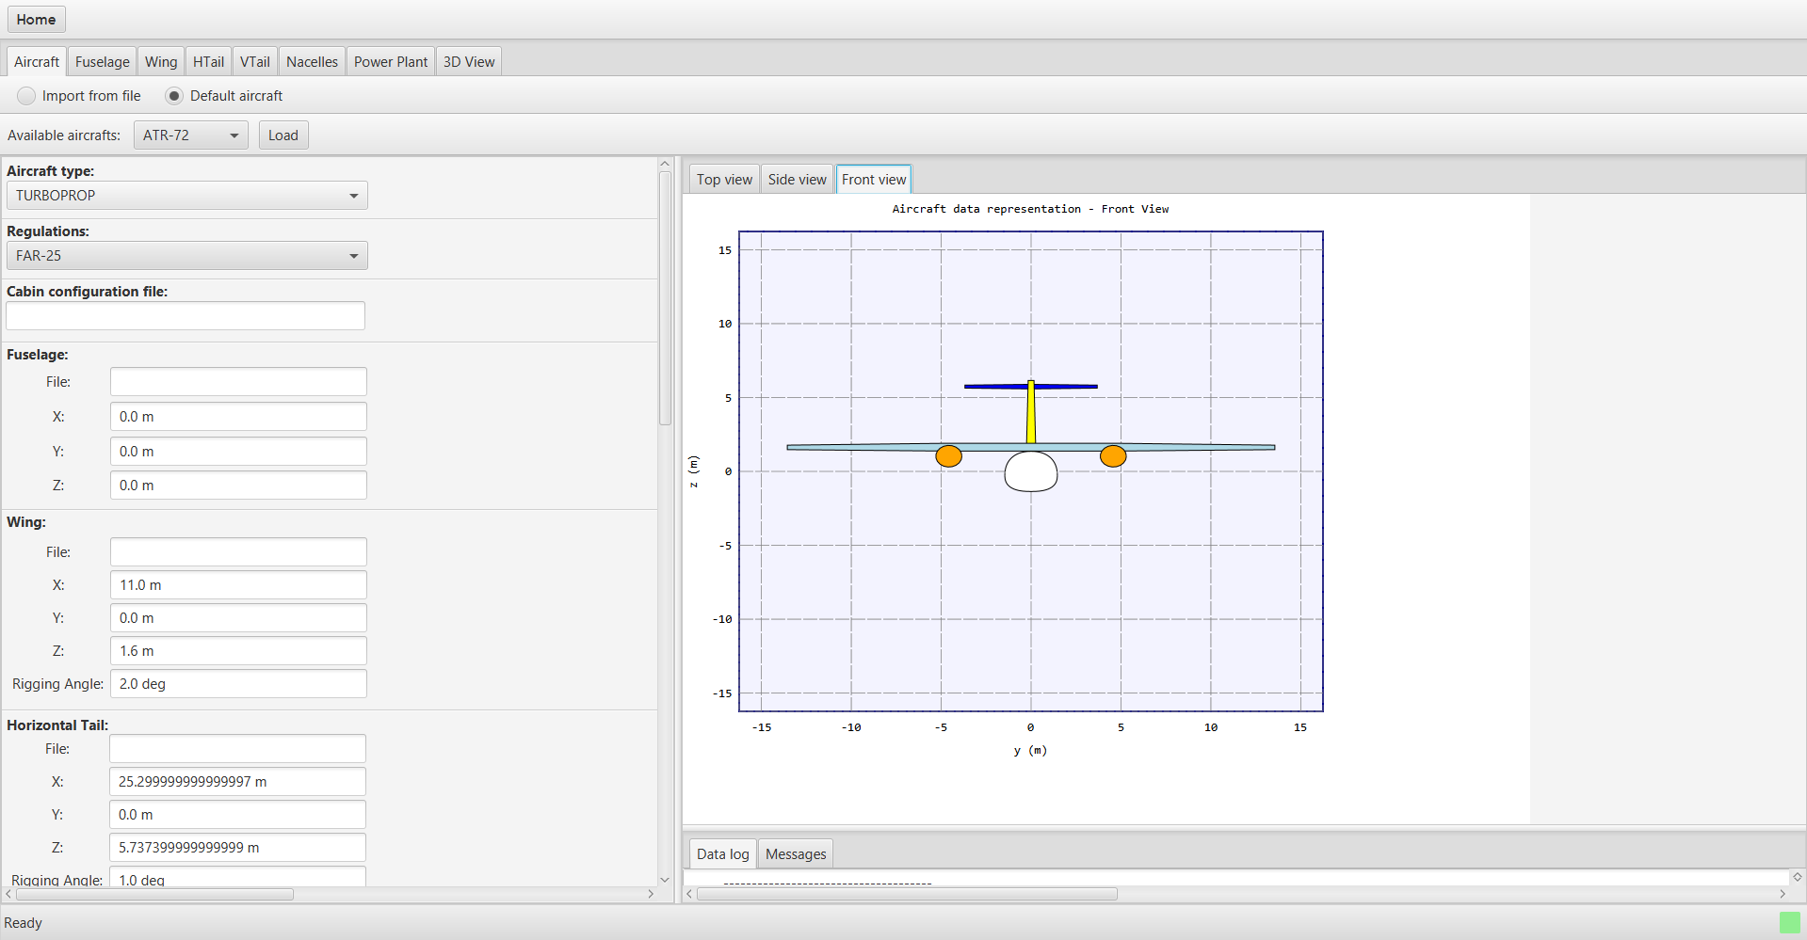
JPADCommander - Input

Slide 6
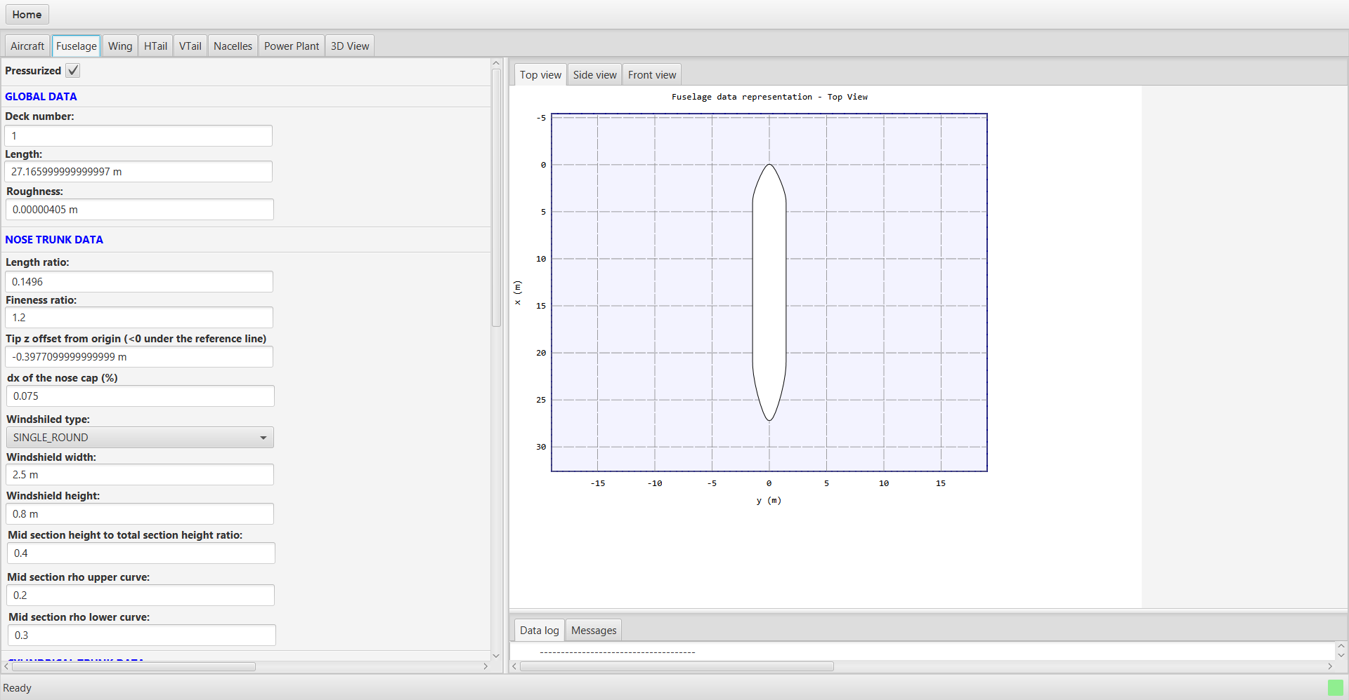
JPADCommander - Input

Slide 7
Work in progress
Analysis Manager:
A modular interface aiming to manage multi-disciplinary analyses.
Weights
Balance
Aerodynamics and Stability
Performance
Costs
Possibility to choose between a complete analysis cycle and standalone analyses thanks to a modular XML input file structure.
Possibility to perform fast multi-objective optimizations or DOE investigations by iteratively launch one or more analysis module. (at the moment a complete analysis cycle takes less than one minute)

